Slide 1
Flow
Problem
Background
Fourier Series
Complex Fourier Series
Fourier Transform
Solve the Problem

Slide 2
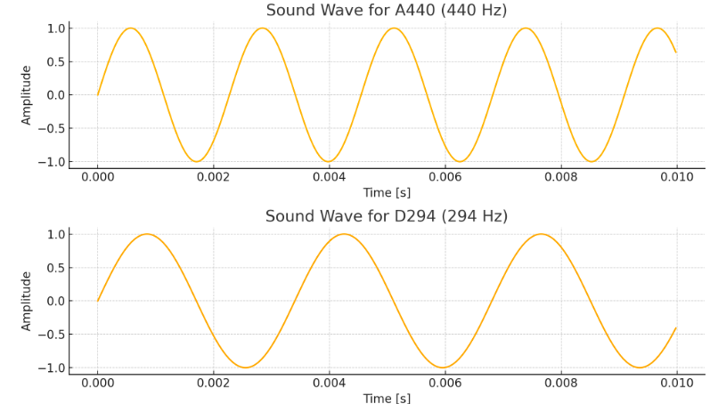
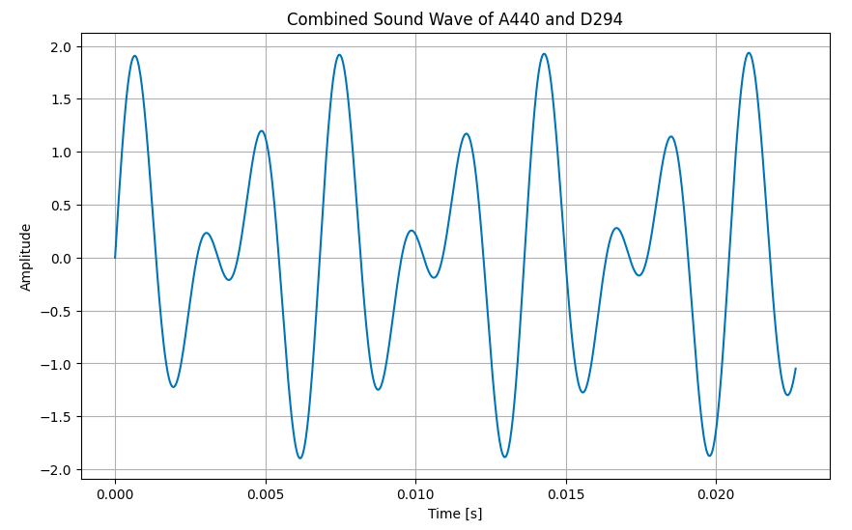
The Problem

Slide 3

Background
The Fourier series was introduced by Joseph Fourier in his work on the theory of heat
He published his seminal work, "Théorie analytique de la chaleur" (The Analytical Theory of Heat), in 1822.
How can the distribution of heat in a rod or a body be mathematically represented and predicted over time?

Slide 4
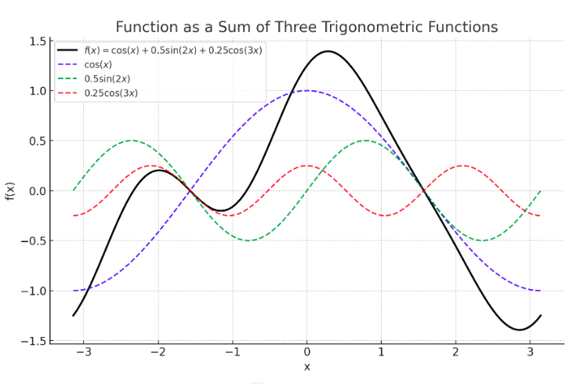
Fourier Series

Slide 5


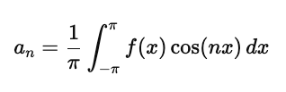
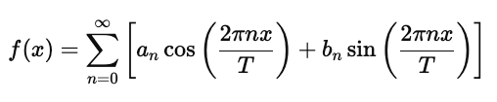


Mathematical Formulation
Fourier series when x is period on domain [−π,π]
Fourier series when x is periodon domain [0,L]

Slide 6




Complex Fouries Series
Fourier Series for real valued function
Euler’s Formula
Fourier Series for complex valued function

Slide 7


Fourier Transform
Fourier Series for real valued function
Fourier Transform
Inverse Fourier Transform

